Slide 1
SECOND INDIVIDUAL PRESENTATION- GROUP 5
INTERFACING SENSOR TO ARDUINO UNO AND DESIGN MACHINE LEARNING ALGORITHM
INSTRUCTOR: PROF. MIKE ALESHAMS
PRESENTER: SOUMYA THAZHATHU PANCHICKAL(C0753009)

Slide 2
Gesture Keyboard- Typing letters by moving in the air with machine learning using Beaglebone Black
The aim of this project is to type letters in the air using hand gestures, where the gestures are sensed by a gyroscope and finally displayed on an LCD display.
The main components used are Beaglebone black, Arduino board, Gyroscope and LCD display.
The machine learning algorithm "Supervised learning" is used with some predictions along with designed project to detect the alphabet. The gyroscope is attached to hand, so when letters are written in air, the data is transferred to the beaglebone black via arduino, where the data is compared with machine algorithm predictions and then, they are displayed.

Slide 3
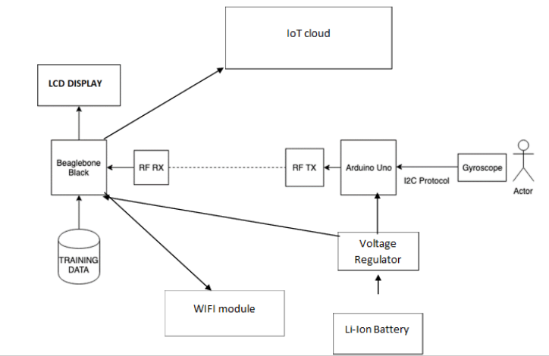

Slide 4
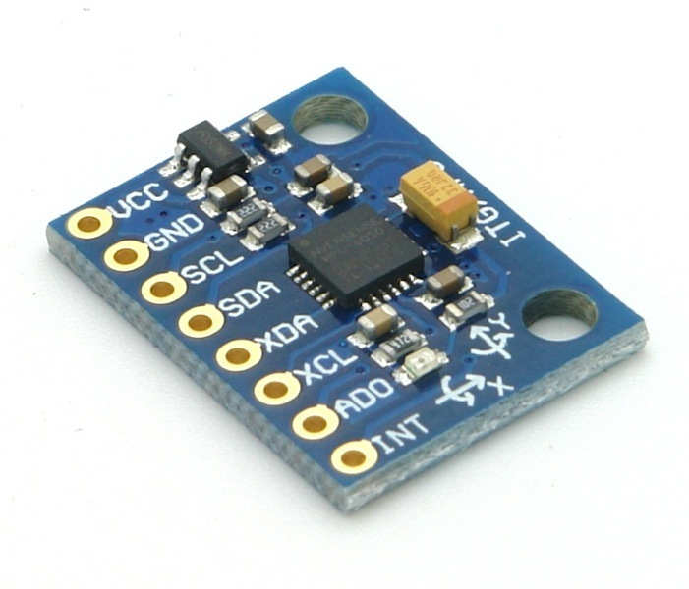
INTERFACING GYROSCOPE SENSOR TO ARDUINO UNO
GYROSCOPE SENSOR
MPU6050 sensor module is an integrated 6-axis Motion tracking device.
It has a 3-axis Gyroscope, 3-axis Accelerometer, Digital Motion Processor and a Temperature sensor, all in a single IC.
It can accept inputs from other sensors like 3-axis magnetometer or pressure sensor using its Auxiliary I2C bus.

Slide 5
The MPU-6050 module has 8 pins,
INT: Interrupt digital output pin.
AD0: I2C Slave Address LSB pin. This is 0th bit in 7-bit slave address of device. If connected to VCC then it is read as logic one and slave address changes.
XCL: Auxiliary Serial Clock pin. This pin is used to connect other I2C interface enabled sensors SCL pin to MPU-6050.
XDA: Auxiliary Serial Data pin. This pin is used to connect other I2C interface enabled sensors SDA pin to MPU-6050.
SCL: Serial Clock pin. Connect this pin to microcontrollers SCL pin.
SDA: Serial Data pin. Connect this pin to microcontrollers SDA pin.
GND: Ground pin. Connect this pin to ground connection.
VCC: Power supply pin. Connect this pin to +5V DC supply.

Slide 6
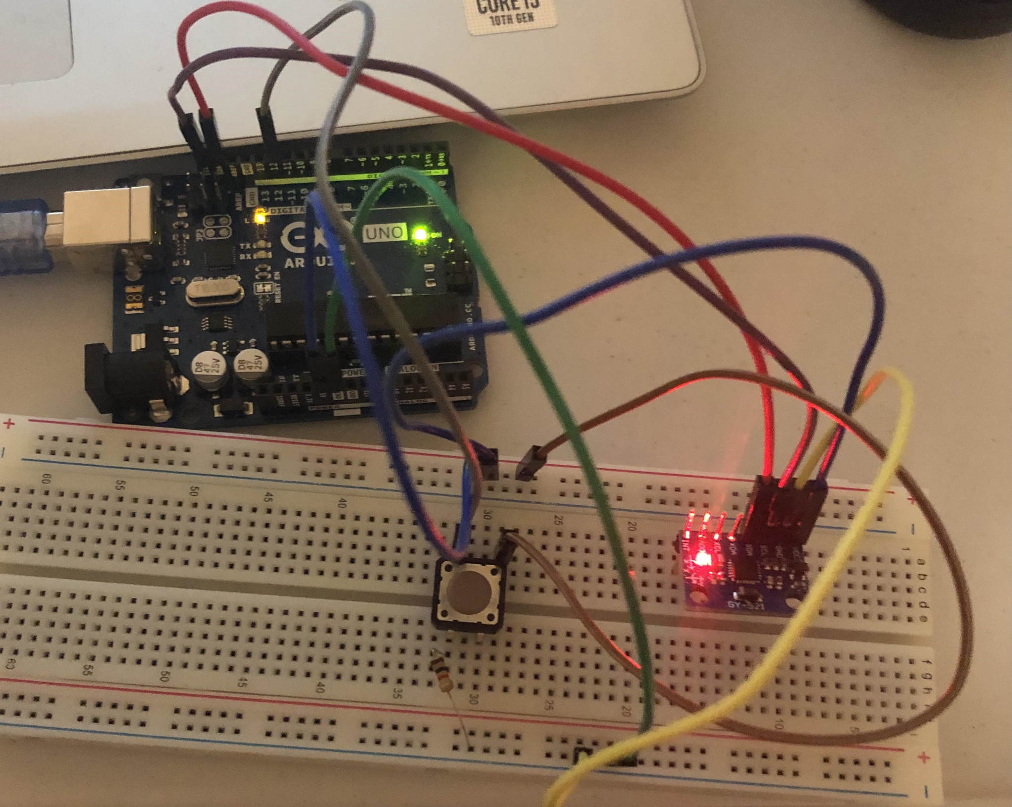
CONNECTING ARDUINO UNO WITH GYROSCOPE SENSOR

Slide 7
ARDUINO IDE
Arduino IDE is used for coding which has a text editor, tool bar for common functions and series of menus
It connects to the arduino board to upload the program and establish communication
Serial monitor initiates the exchange of data with any connected board on the currently selected port. Port contains all the serial devices on your machine.

Slide 8
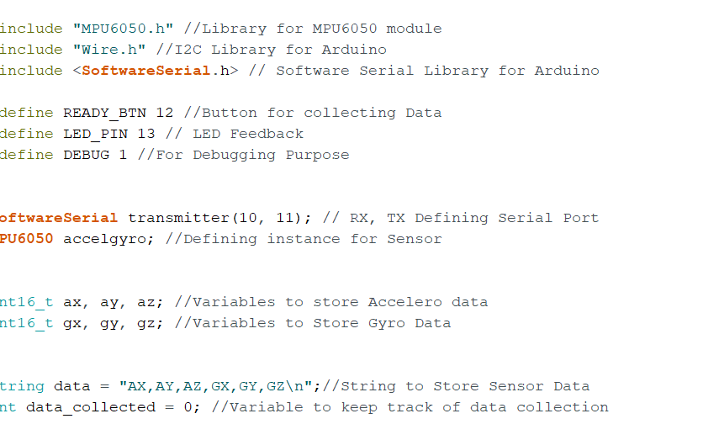
CODE FOR INTERFACING SENSOR WITH ARDUINO BOARD

Slide 9
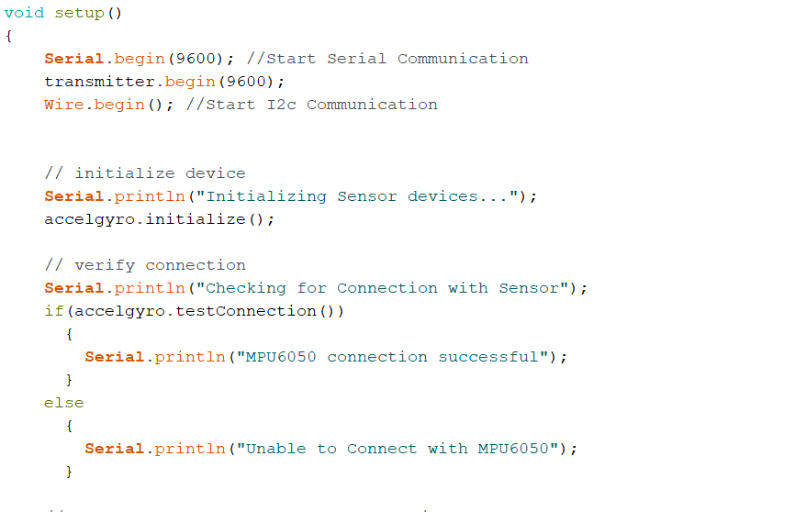
Cont........
INITIALIZATION

Slide 10
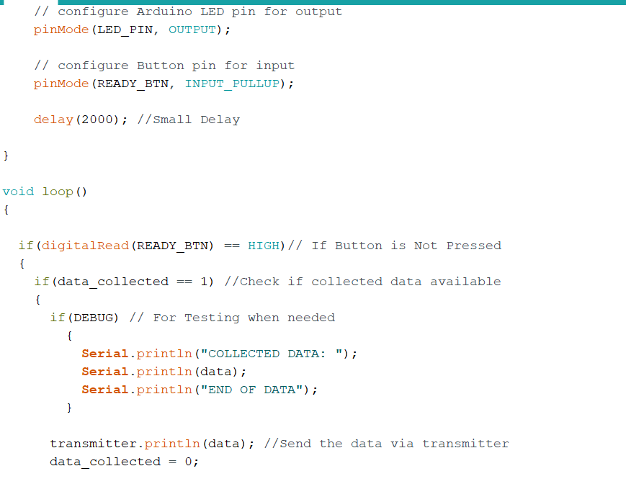
Cont...............
DISPLAYING
DATA

Slide 11
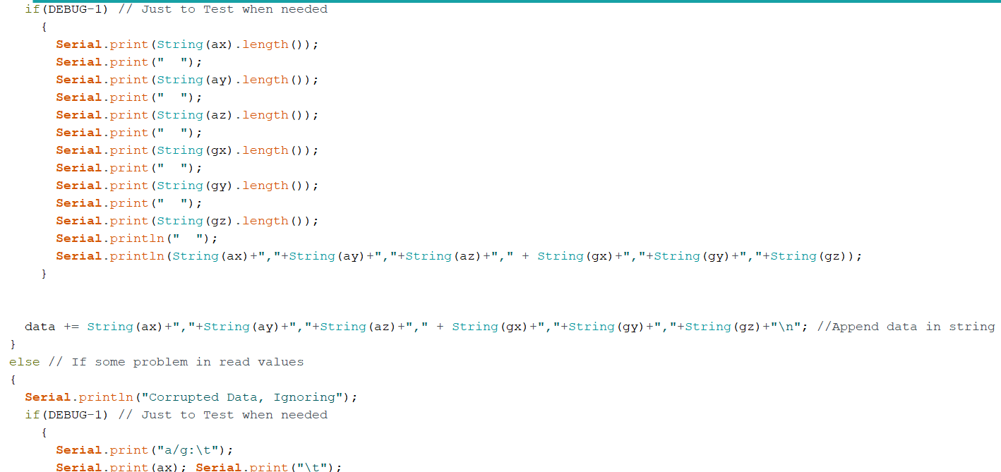
Cont..............

Slide 12
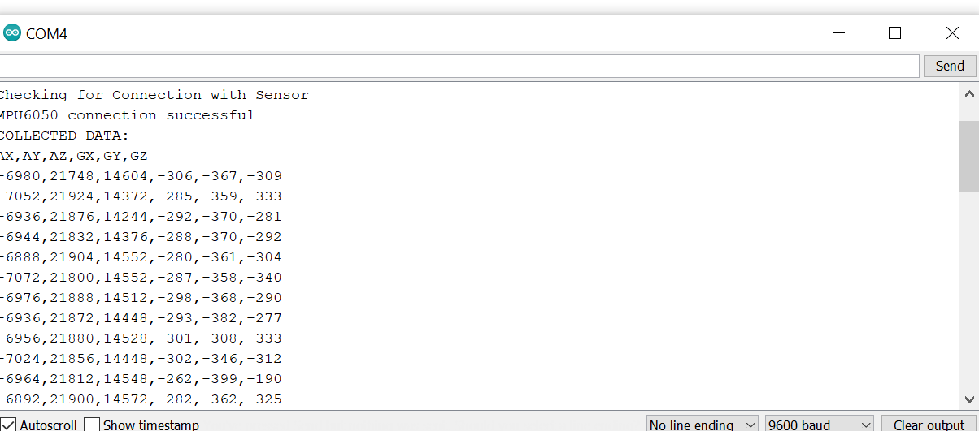
ACCELEROMETER AND GYROSCOPE VALUES

Slide 13
REFERENCES
Electronicwings(n.d.). MPU6050 interfacing with Arduino UNO. Retrieved October 30,20 from https://www.electronicwings.com/arduino/mpu6050-interfacing-with-arduino-uno#
Arduino(n.d.). Arduino software IDE. Retrieved October 30,2020, from https://www.arduino.cc/en/guide/Environment
Tutorial gyroscope and accelerometer. Retrieved November1,2020 from https://www.youtube.com/watch?v=wTfSfhjhAU0

